Slide 1
Introduction to Excel – Part 5
Formulas

Slide 2
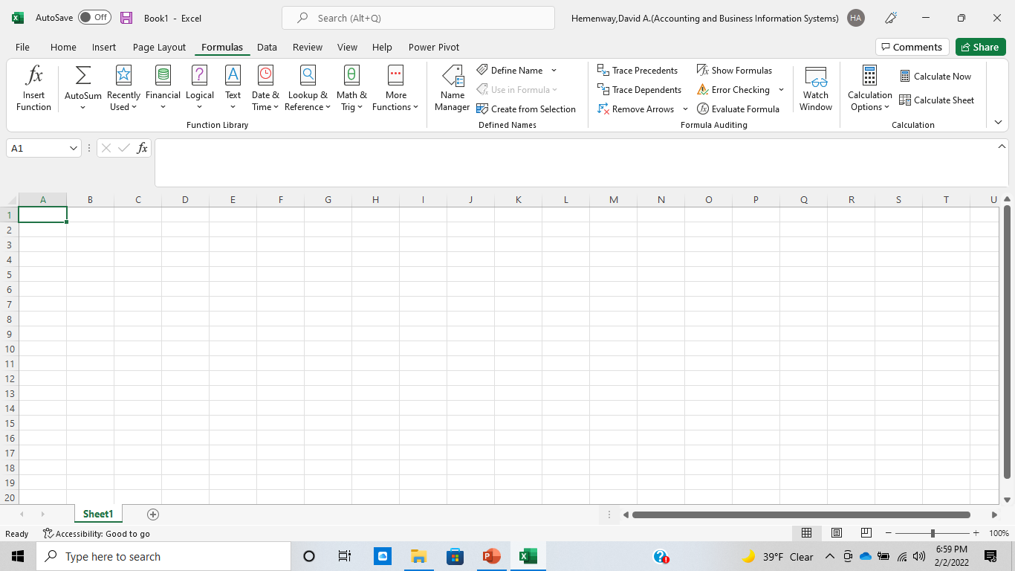
Formulas

Slide 3
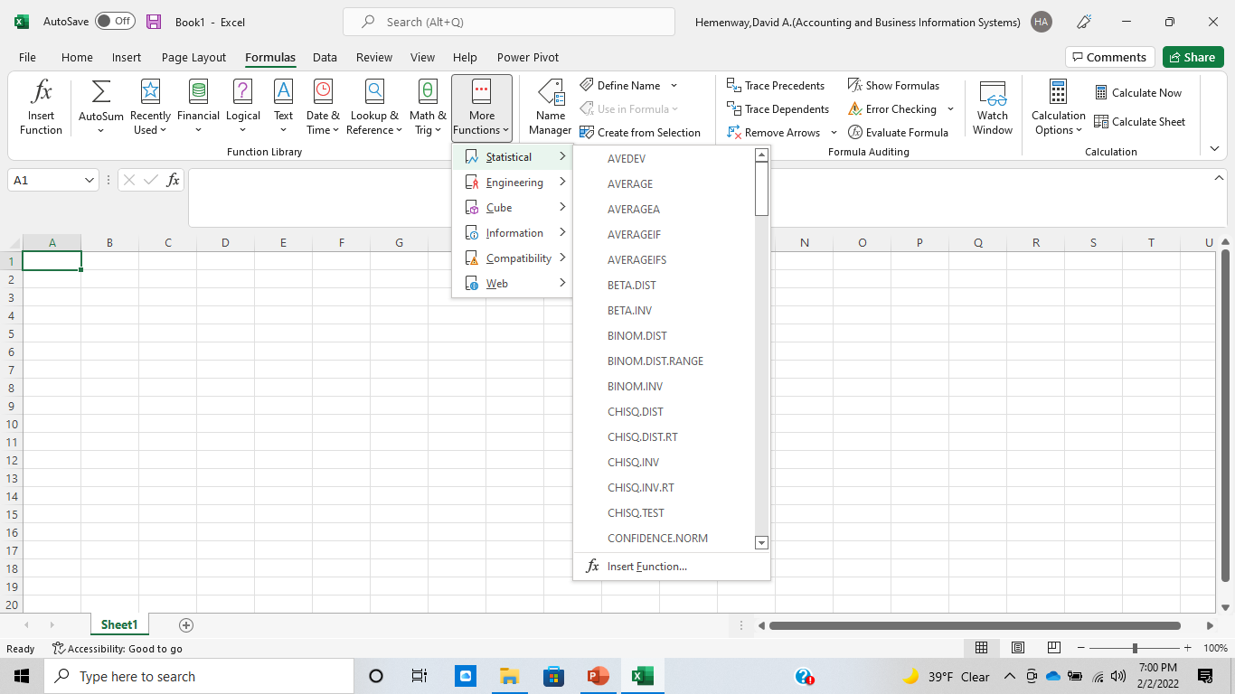
Formulas

Slide 4
Formulas
Entering a function formula
Entering a cell formula
Click the cell where you want to enter the cell formula
Enter the equals (=) sign
Enter the formula
Press Enter
Click the cell where you want to enter the function formula
Select the formula ribbon or the Auto Sum function
Highlight the cells included in the formula
Press Enter

Slide 5
Effective Formula Guidelines
Keep them simple
Do not hide data values within formulas
Use parentheses to simplify formulas
Break up formulas to show intermediate results
When possible, keep formula methods similar
Review/Check formulas
Others???

Slide 6
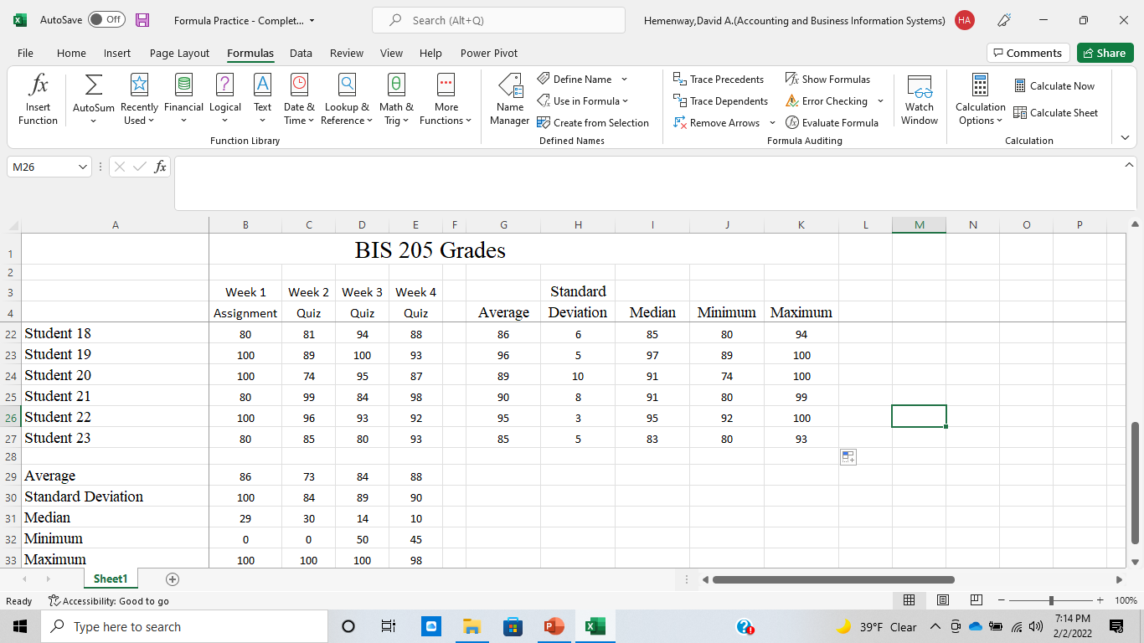
Formula Practice Spreadsheet

Slide 7
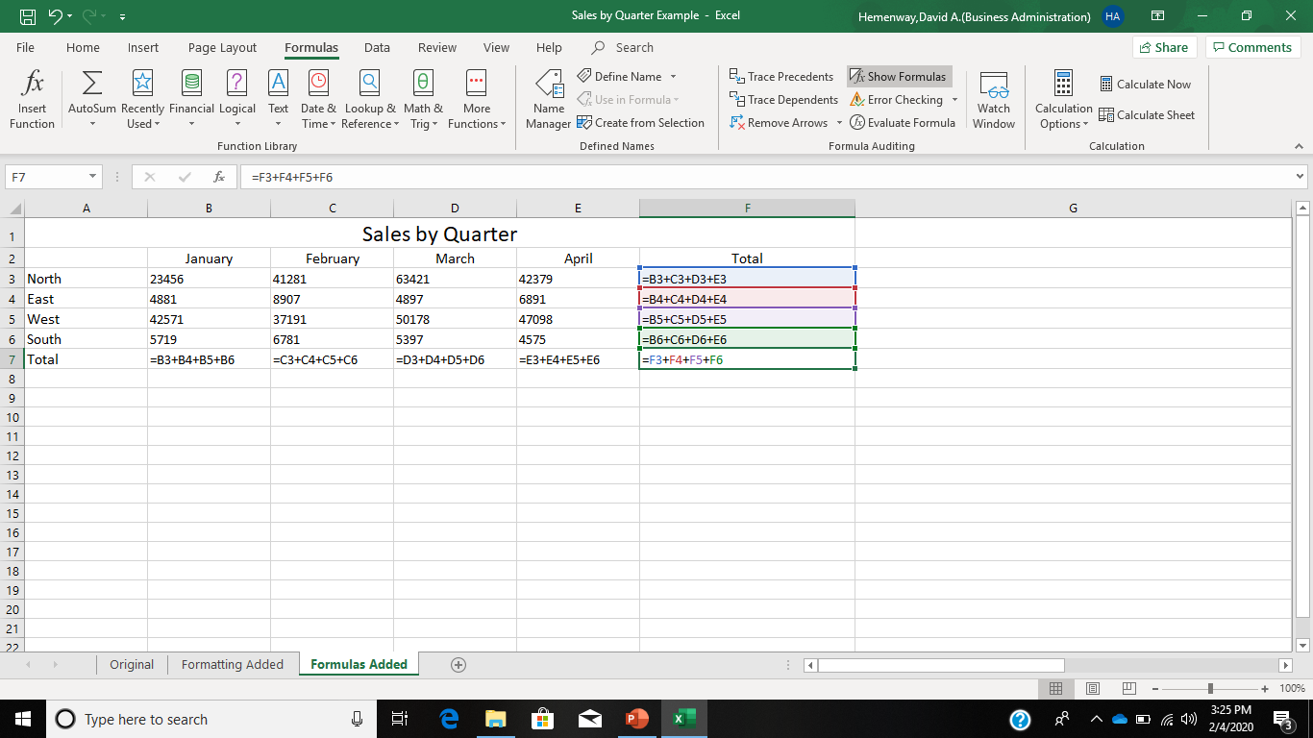
Show Formula Command

